Slide 1
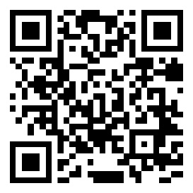
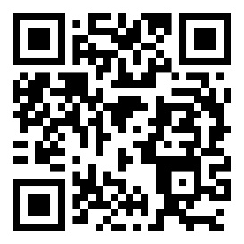
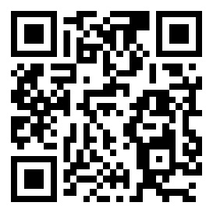
RISE
Rising competences & skills in less developed Danube regions through food sector cross-topic innovations
This project is supported by the Interreg Danube Region Programme co-funded by the European Union.
2.062.153 €
Project Budget
1.649.722 €
Interreg Funds
1/2024-6/2026
Project duration
https://interreg-danube.eu/projects/rise
Maja Sušec
maja@p-tech.si
+386 2 530 8232
Plese 9a
9000 Murska sobota, Slovenia
LinkedIn
Facebook
YouTube

